Slide 1
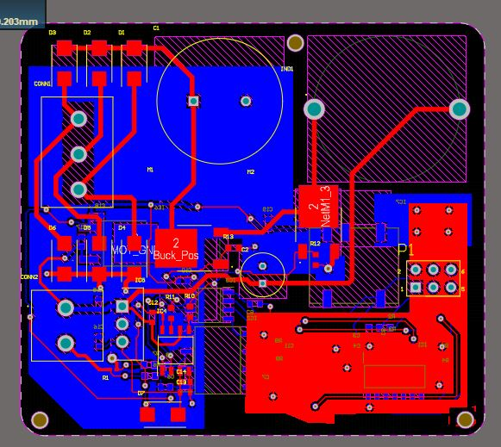
Rectifier Capacitor
Buck Inductor
High Side Diodes
Motor Connector
Low Side Diodes
Battery Connector
Shunt Resistor
MOSFET High
Buck Capacitor
MOSFET Low

Slide 2
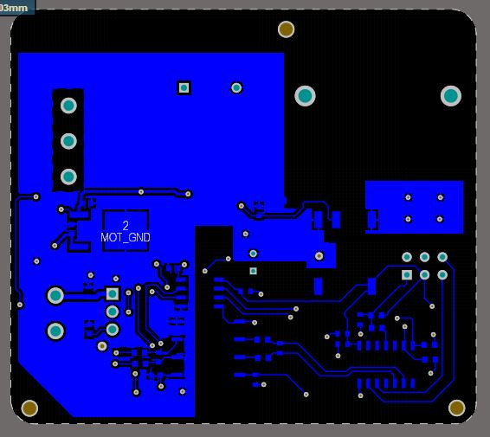
MOT_GND Plane
ISOLATION BOUNDARY
ISO_GND Plane
Controller Connector
Digital Isolator
Isolated Op-amp
Microcontroller

Slide 3
24V/3V3 Conversion
3V3 Isolated Conversion
24V/12V Conversion

Slide 4
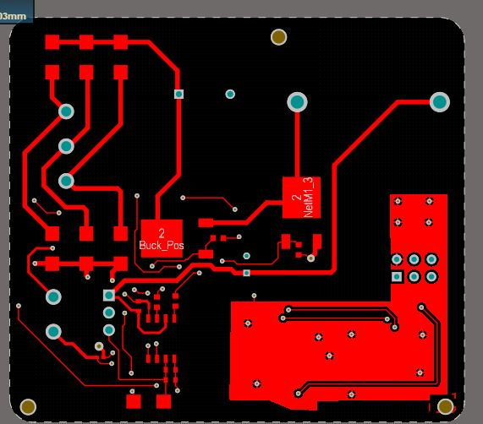
Fiducial
Gate Driver
Fiducial
Bootstrap Diode
Fiducial

Slide 5
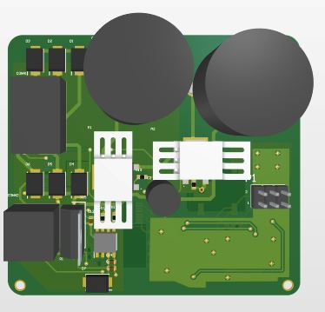
Rectifier Capacitor
Buck Inductor
High Side Diodes
Motor Connector
MOSFET Low w/heatsink
Low Side Diodes
Controller Connector
Battery Connector
24V/12V Conversion
Bootstrap Diode
Gate Driver
MOSFET High w/heatsink
Buck Capacitor

Slide 6
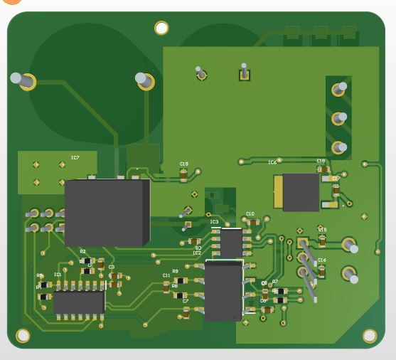
24V/3V3 Conversion
3V3 Isolated Conversion
Digital Isolator
Isolated Op-amp
Microcontroller

